Slide 1
Bell Work: 1.) Write the equation, and graph the line through (-4, 2) and (0, 7) 2.) Graph: 4x – 3y = 12

Slide 2
From Last Time…
New Material
Page 78 #1, 3, 5, 9, 19, 23, 29, 33, 49
Mixed Review
Page 80 #67-70

Slide 3
ALGEBRA 3
Day 17

Slide 4
Chapter 2 Section 4 More about Linear Equations
Objective: Write equation of line through any two points
HLQ: How does the process for writing a line change, if we are not given the y-intercept as one of our two points?

Slide 5
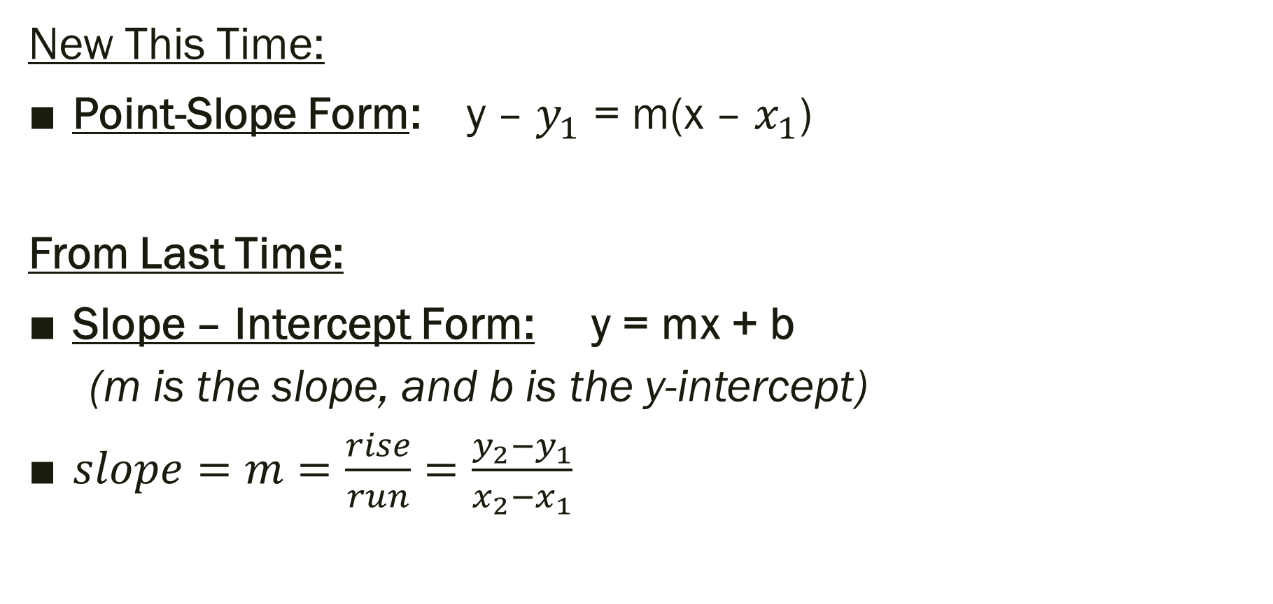
Linear Equations:
New This Time:
Point-Slope Form: y – $y_{1}$ = m(x – $x_{1}$)
From Last Time:
Slope – Intercept Form: y = mx + b
(m is the slope, and b is the y-intercept)
$slope=m=\frac{rise}{run}=\frac{y_{2}−y_{1}}{x_{2}−x_{1}}$

Slide 6
Reminder about slopes of specific lines
Parallel Lines:
Have Slopes that are Equal
Perpendicular Lines:
Have slopes that are Opposite Recipricals

Slide 7
Examples: Write the Equation
1.) The line has a slope of -1/2 and goes through (2,3)
2.) m = 3 and through (5, 2)

Slide 8
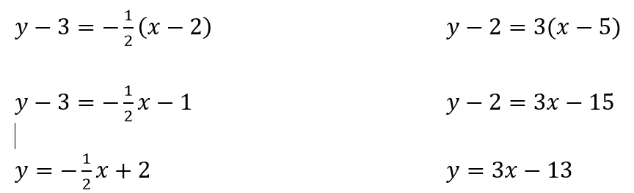
Example Work Shown:
1.) The line has a slope of -1/2 and goes through (2,3)
2.) m = 3 and through (5, 2)

Slide 9
Write Equation through (-2, -1) and (3, 4)

Slide 10

Write Equation through (-2, -1) and (3, 4)
$$m=\frac{4−(−1)}{3−(−2)}=\frac{5}{5}=1$$
$$y−4=1\left(x−3\right)=>$$

Slide 11
Example:
Write an equation of the line that passes through (4, 6) and is parallel to the line that passes through (6, -6) and (10, -4)

Slide 12
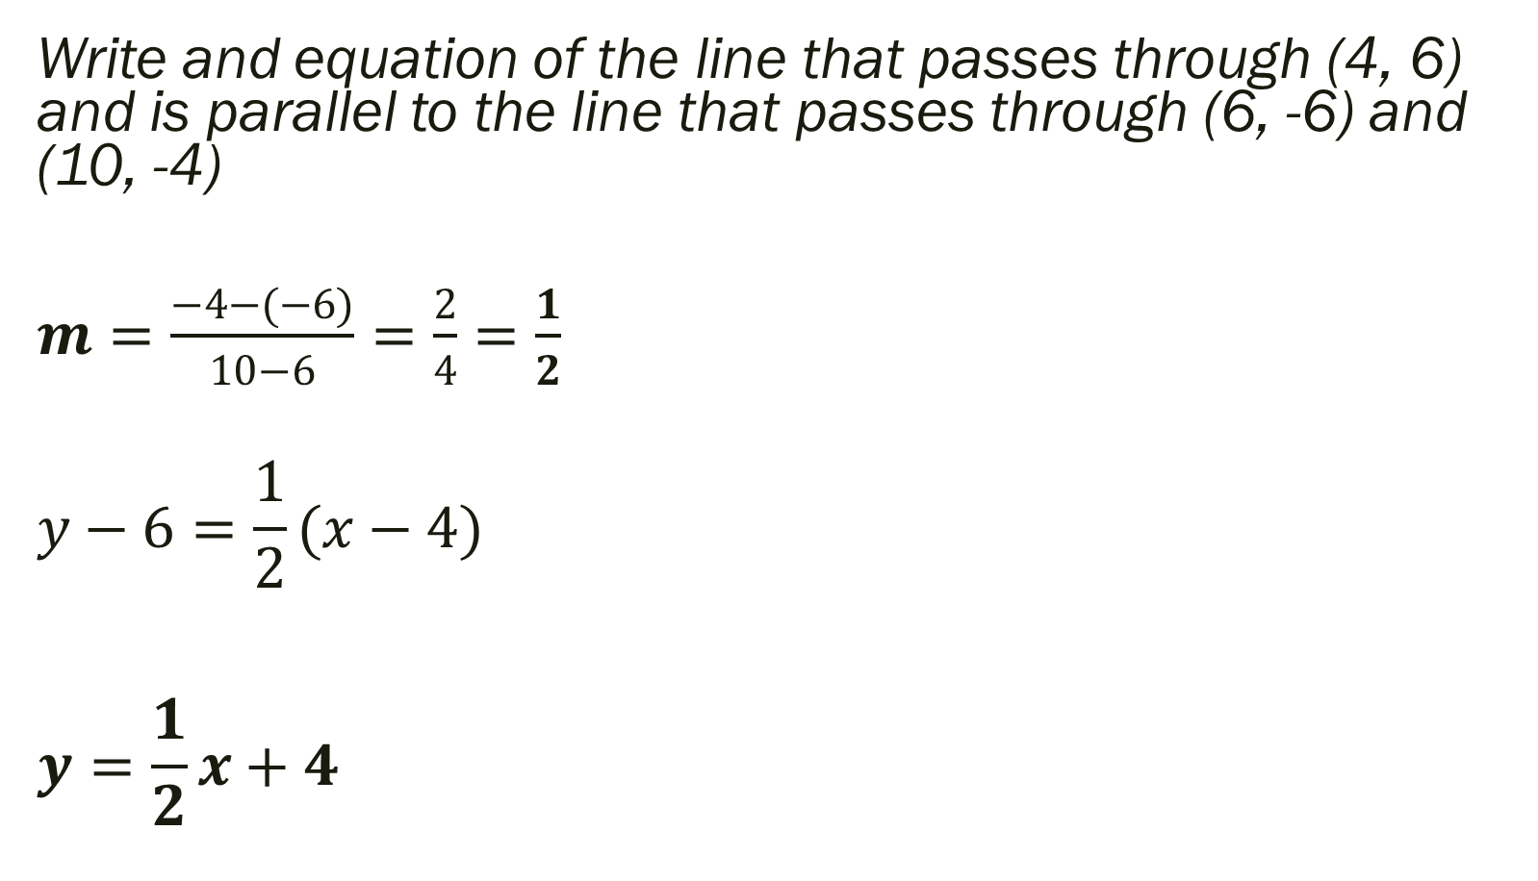
Example Answer
Write and equation of the line that passes through (4, 6) and is parallel to the line that passes through (6, -6) and (10, -4)
$m=\frac{−4−(−6)}{10−6}=\frac{2}{4}=\frac{1}{2}$
$$y−6=\frac{1}{2}(x−4)$$
$$y=\frac{1}{2}x+4$$

Slide 13
For Next Time…
New Material
Page 86 #1, 11, 17, 19, 27, 32
Mixed Review
Page 88 #60, 62, 66, 67

